Slide 1
SADDLEBACK SCHOLARS

Slide 2



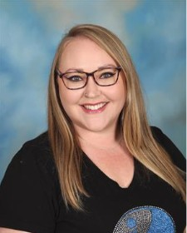


SADDLEBACK SCHOLARS
Dr. Osman- Principal
Mrs. LaBare - IB Coordinator 7th & 8th Grade
Mr. Shalash - Assistant Principal 9th & 10th Grade
Mr. Iturralde - Assistant Principal 11th & 12th Grade

Slide 3
WHO ARE WE?
“We will work together to deliver rigorous instruction and personalized support to provide a successful transition to higher education and beyond, while promoting lifelong learning.”
TEAMWORK
RESPONSIBILITY
KNOWLEDGE

Slide 4


Objectives
Students will identify and demonstrate school-wide behavior expectations
Students will be able to recognize the impact their behavior has on themselves and others
Students will identify problem-solving strategies to stay on TRACK! Students will TRACK and reflect on their behavioral growth
TEAMWORK
RESPONSIBILITY
KNOWLEDGE

Slide 5
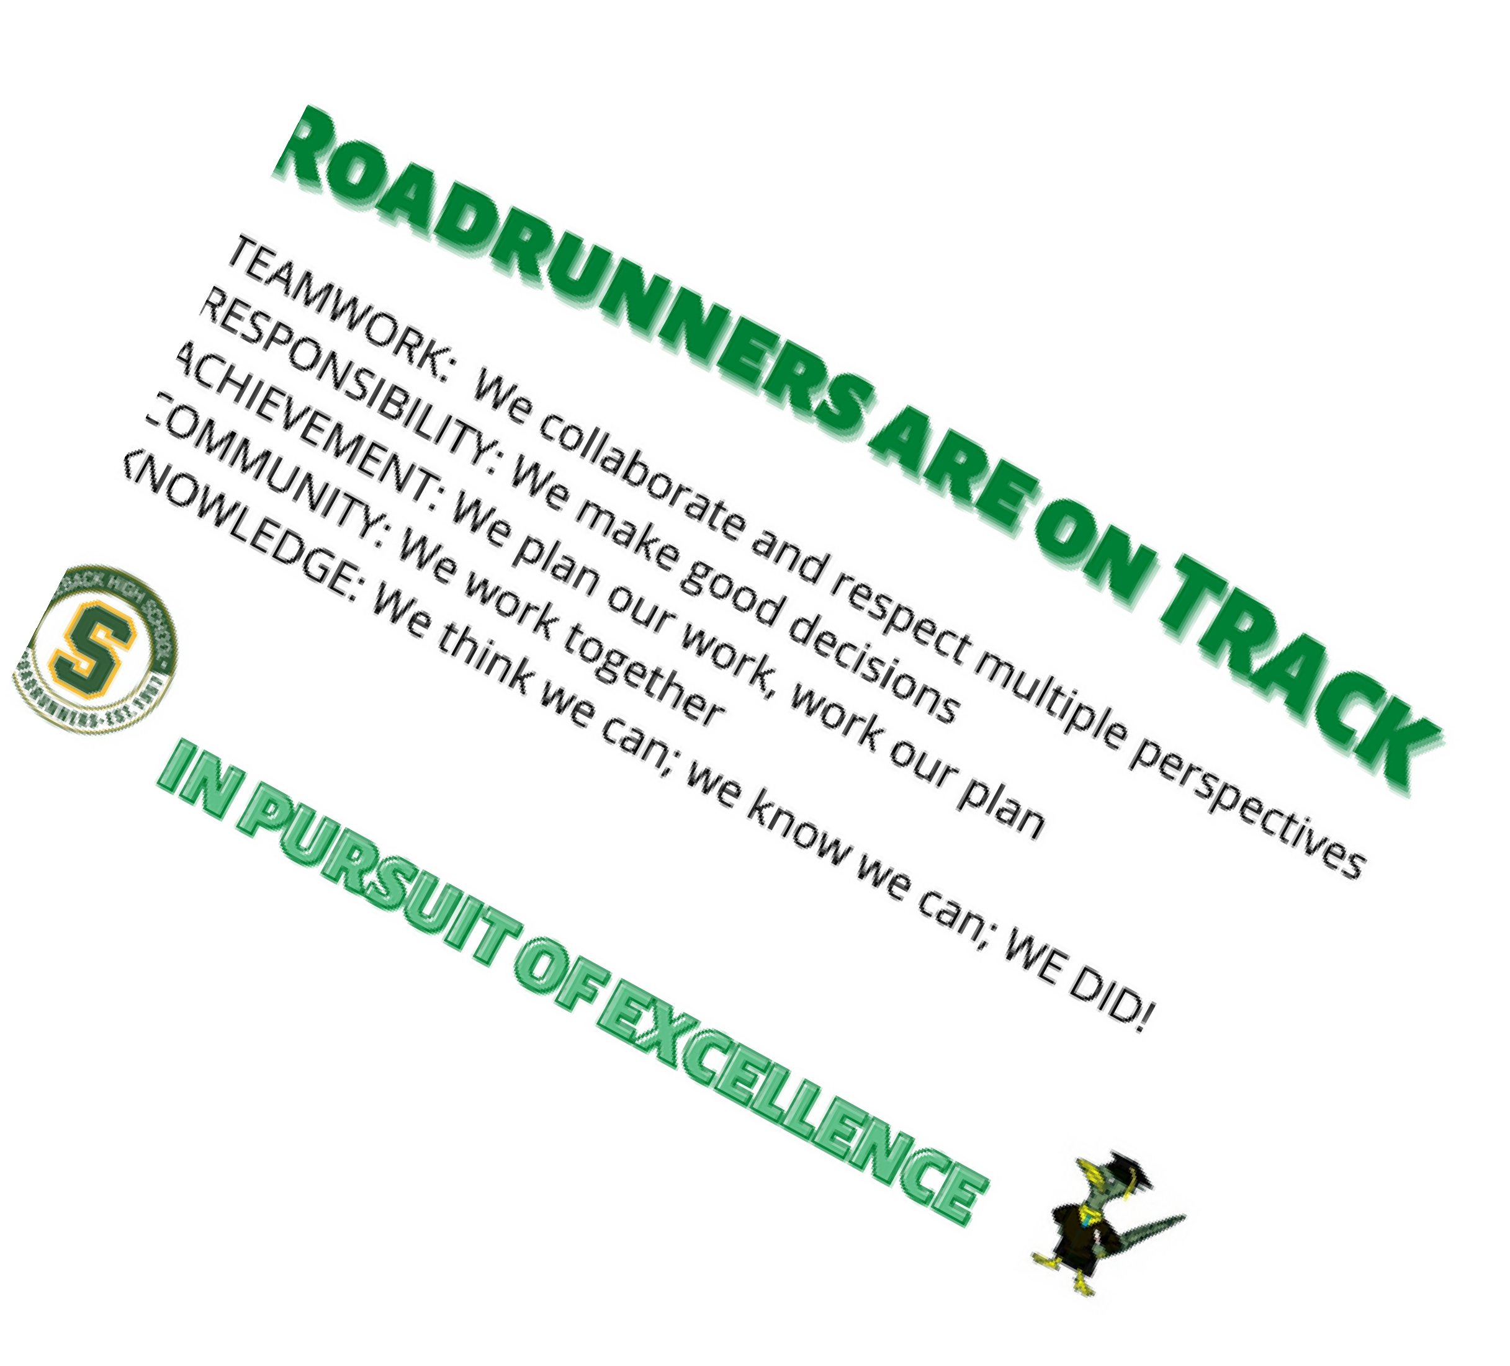
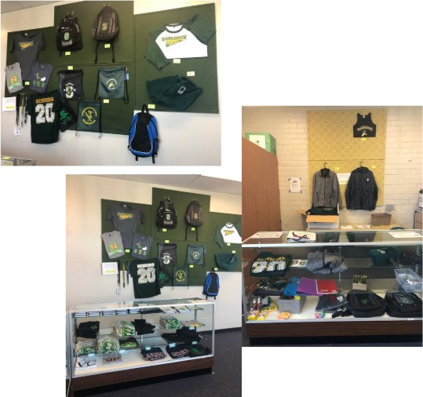
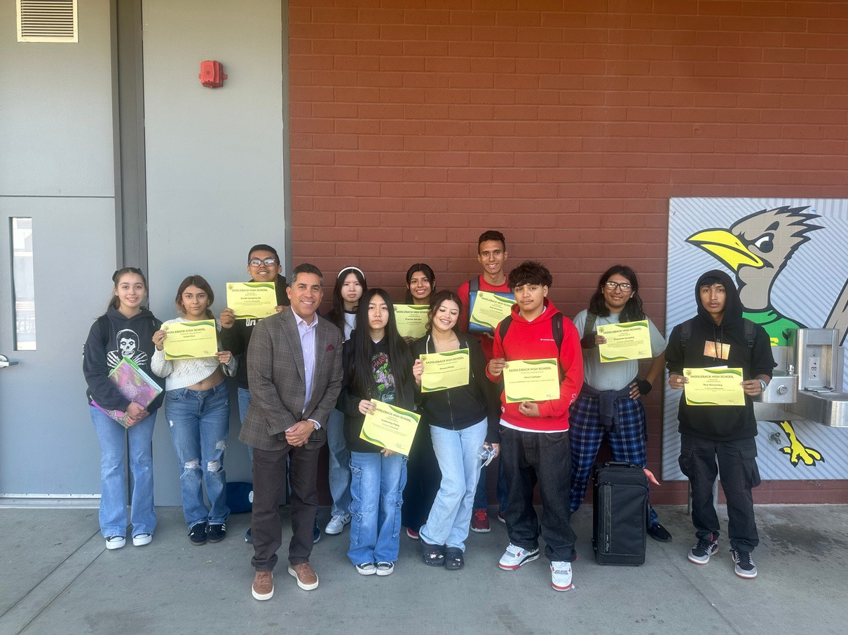
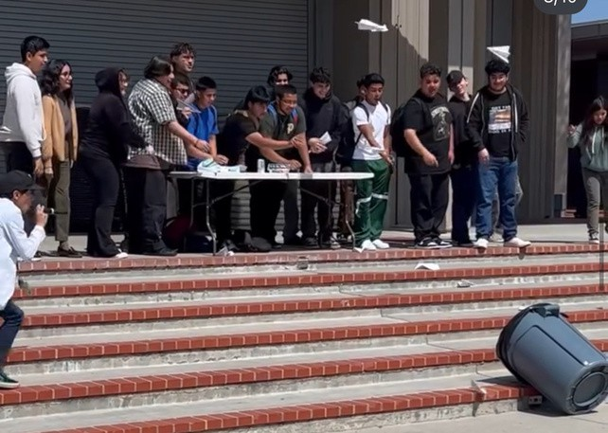
School-Wide Expectations
Display TRACK Behaviors
Earn TRACK Cards
Use TRACK Cards to get SWAG!
TEAMWORK
RESPONSIBILITY
KNOWLEDGE

Slide 6




Attendance & Illness
Monthly Perfect
Attendance & TRACK
Regular attendance is vital to your success at Saddleback! Any Absence-Requires a valid reason
Not all absences are excusable
Cards
Excused
Medical/Dental Appointment/Illness Court Date/ Immigration Appointments Bereavement
School Business
Unexcused
Babysitting
Oversleeping/ getting ready Vacation
Skipping
Illness
Must come to the nurse’s office for evaluation Don’t call parents ahead of time
Clear Absences-ASAP Doctor’s Note-Proof
TEAMWORK
RESPONSIBILITY
KNOWLEDGE

Slide 7



Tardy Policy
Tardy- 1-20 minutes late Truancy- 21 minutes or more.
An absence will be considered a truancy if not excused
1st Tardy 2nd Tardy 3rd Tardy
Warning
Parent Contact
Parent Contact & Teacher Assigned Consequence
4th Tardy
Teacher Assigned Consequence
WIN Afterschool
5th, 8th, 10th Tardy
TEAMWORK
RESPONSIBILITY
KNOWLEDGE

Slide 8



Tutorial
Tutorial is required!
Tutorial Sweep
Students will be sent to the forum Phones will be taken
30 minutes afterschool detention until 4pm
TEAMWORK
RESPONSIBILITY
KNOWLEDGE

Slide 9







Student Conduct
Dress Code
Hoodies Hats
Plain Shirts Cell Policy
S
Headphones or earbuds Skateboards/bikes
TEAMWORK
RESPONSIBILITY
KNOWLEDGE

Slide 10



Dress Code-Hats & Hoodies
S
Only Saddleback hats are allowed on campus
The only exception to the hats is on Wednesday where you can wear a college hat.
Can only be worn outdoor (not in buildings or classrooms)
No Hoodies worn over head except when weather permits (outdoors)
Violation of school dress code can lead to consequences, including parent conference, issuing of spirit wear, detention, campus beautification, or other consequences issued by admin.
TEAMWORK
RESPONSIBILITY
KNOWLEDGE

Slide 11
Dress Code-Clothing & Shoes
Page 12 in
No professional jerseys or shirts with team logos No plain colored t-shirts
Clothing should conceal undergarments at all times. No bare midriffs, low-cut tops, or shorts shorter than mid-thigh
Sandals WITHOUT straps are not allowed
No clothing or belt buckles with logos or initials related to drugs, weapons
Violation of school dress code can lead to consequences, including parent conference, issuing of spirit wear, detention, campus beautification, or other consequences issued by admin.
Student Agenda
TEAMWORK
RESPONSIBILITY
KNOWLEDGE

Slide 12
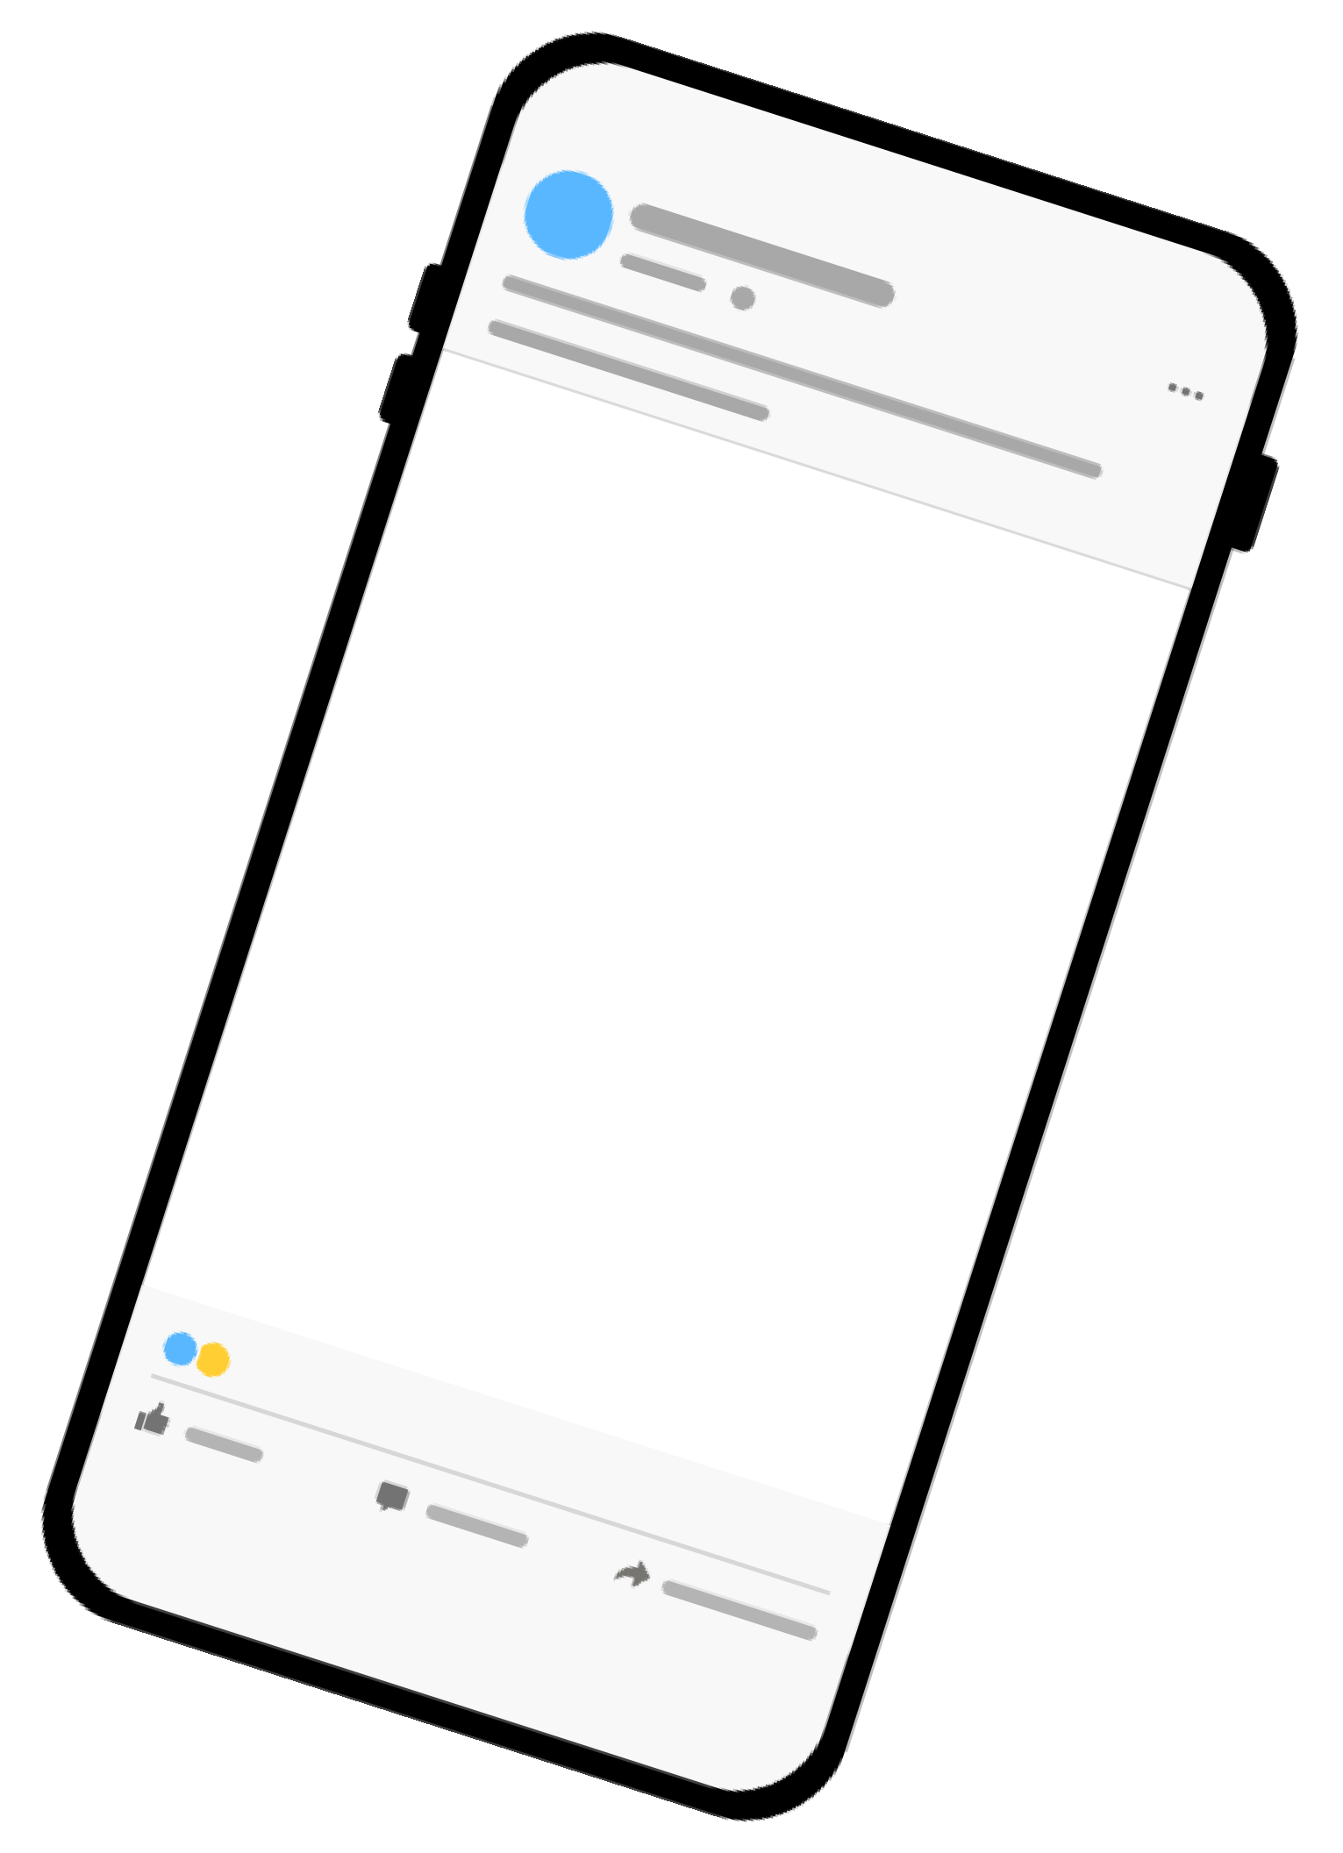

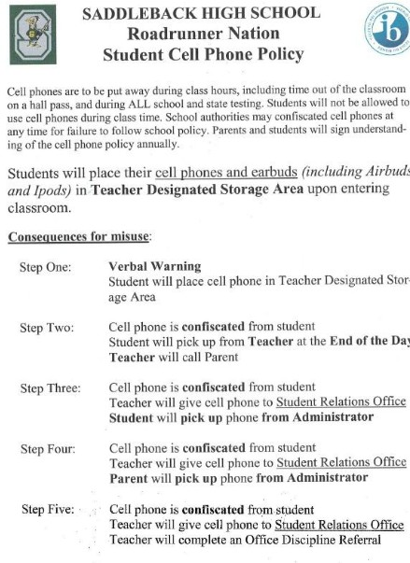
Phones & Earbuds
Use phone pockets if required by teacher.
Follow teacher’s classroom expectations on use of phones and earbuds in class.
Reminder: Students are not allowed to take pictures or video of other students.
Sending pictures or video to others on phone is illegal.
Page 12 in Student
Agenda
TEAMWORK
RESPONSIBILITY
KNOWLEDGE

Slide 13



Skateboards, Scooters & Bikes
Please walk all bikes, scooters and skateboards when on campus.
Leave bikes, scooters and skateboards in designated area at front of school
HELMETS PLEASE!
TEAMWORK
RESPONSIBILITY
KNOWLEDGE

Slide 14


LUNCH
Attend your assigned lunch
Taking two lunches is considered truancy!
No outside deliveries are allowed during school hours Please make sure to clean up after yourself!
Participate in lunchtime activities
TEAMWORK
RESPONSIBILITY
KNOWLEDGE

Slide 15



Chromebooks
Bring your Chromebook to school charged! Bring broken devices to the library.
Buy insurance to cover repair costs.
Check out a Chromebook Loaner if you don’t have one, but you will turn in your cell phone.
Do not loan it to friends.
Do not leave it in your teacher’s classroom.
Alert: Do not look at certain websites, you will get flagged. Do not charge your cell phones.
TEAMWORK
RESPONSIBILITY
KNOWLEDGE

Slide 16
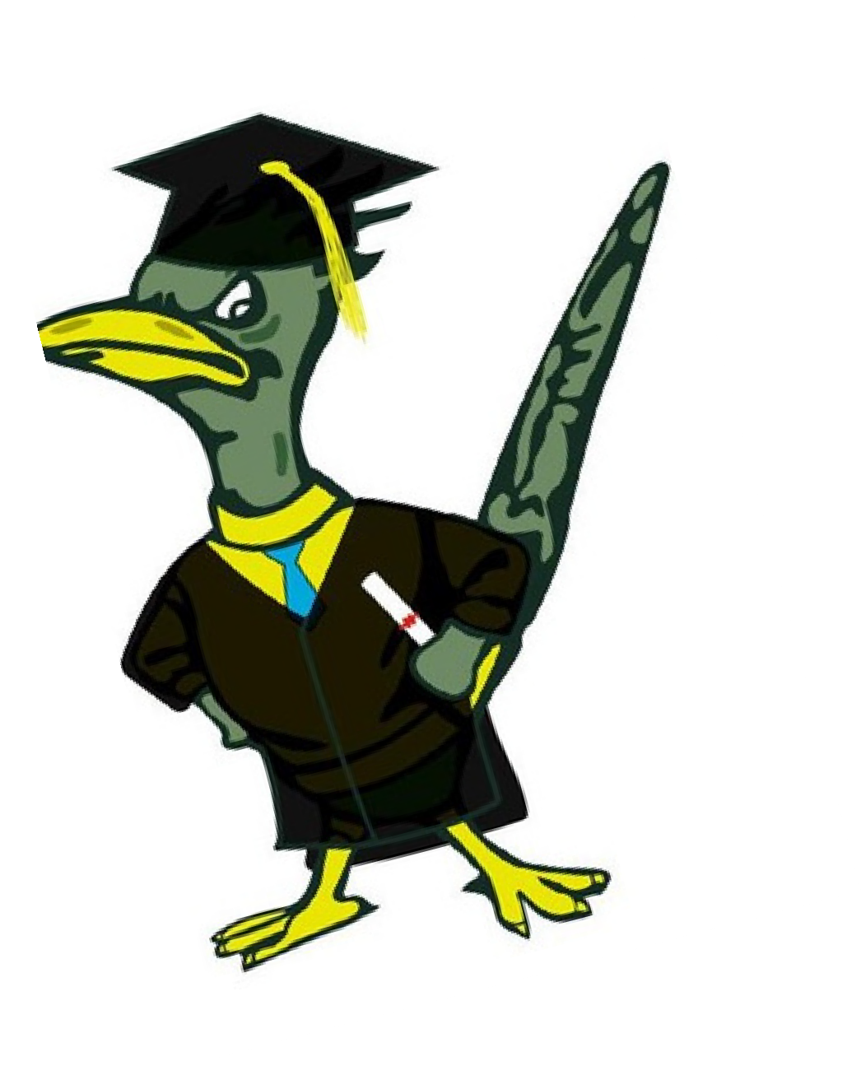

Grading Policy
_{cel} Honor Roll to
ebrate Academ
Achievement
ic
Grade 1st Semester 2nd Semester
9 | 30 | 60
10 | 90 | 120
11 | 150 | 180
12 | 210 | 240
Stay on TRACK to graduate by passing all of your classes
TEAMWORK
RESPONSIBILITY
KNOWLEDGE

Slide 17
School Activities
Senior Sunrise Homecoming Spirit Weeks Assemblies Dances
Prom
Senior Sunset Grad Night Awards Night Athletic Games
TEAMWORK
RESPONSIBILITY
KNOWLEDGE

Slide 18





Words of Wisdom
Pass all your classes with a “C” or better
Remember: Wherever you wear Saddleback gear, be aware that you represent the school. Use your Student Agenda
Check Student Portal daily Join a club!
Represent yourself and not someone else (plagiarism) Get help! Use your resources
Teachers Counselors Free tutoring Clubs
Sports
TEAMWORK
RESPONSIBILITY
KNOWLEDGE

